Slide 1

CASE STUDIES ON
DISNEYLAND REVIEWS
PRAKASH KOTIAN

Slide 2

THE KEY
ELEMENTS
01
EXPLARATORY DATA ANALYSIS
02
BIGRAM & TRIGRAM ASSOCIATION
03
SENTIMENT ANALYSIS
04
EMOTION DETECTION
05
TOPIC MODELING
06
CLASSIFICATION MODELING

Slide 3


Project Goal
Though this NLP study, I wish to identify customer sentiment regarding Disney Land experience based on reviews by visitors. The reviews are from three locations of Disney Land at California, Paris, and Hong Kong.
I used Textblob, Vader, NRCLex, spacy, genism libraries in python to carry out sentiment analysis, emotion detection, and n-gram associations. I have also done topic modelling using which we can Identify visitor pain points and improve park experience

Slide 4

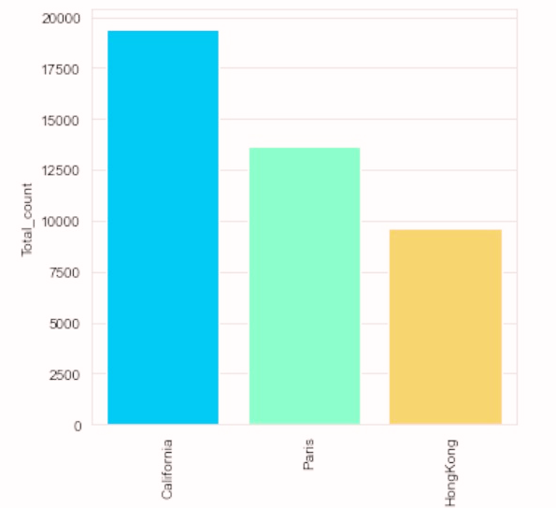

DATASET :
THE DATASET IS FOUND IN KAGGLE CONTAINING 42,000 REVIEWS FROM TRIPADVISOR ABOUT THREE DISNEYLAND BRANCH LOCATIONS: CALIFORNIA, PARIS, HONG KONG.
THERE ARE 19,406 REVIEWS ABOUT CALIFORNIA, 13,630 ABOUT PARIS, AND 9,620 ABOUT HONG KONG. DATA VARIABLES INCLUDE REVIEW_ID, RATING, YEAR_MONTH, REVIEWER_LOCATION, REVIEW_TEXT, AND DISNEYLAND_BRANCH.

Slide 5

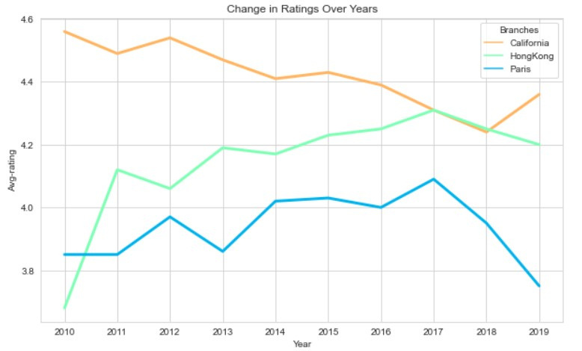
EDA
First step is exploratory data analysis (EDA) to get an idea of average ratings across all locations, how the ratings changed over time and where our visitors are from
The ratings of DL in California have been decreasing over the years. Still, ratings of DL Hong Kong have been significantly improving, avg Ratings for DL Paris have improved since 2014 but after 2017 there was a sudden decrease.

Slide 6

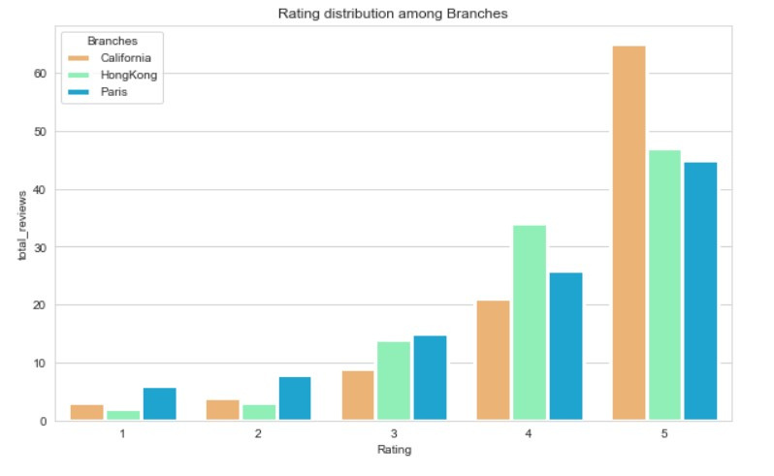




RATING DISTRIBUTION AMONG BRANCHES

Slide 7
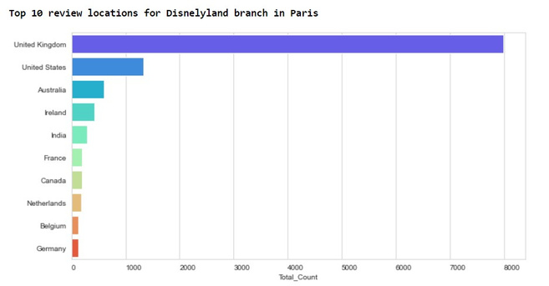
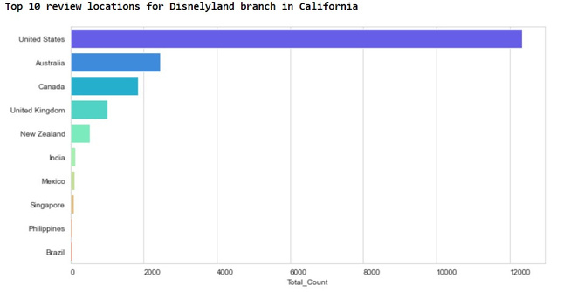
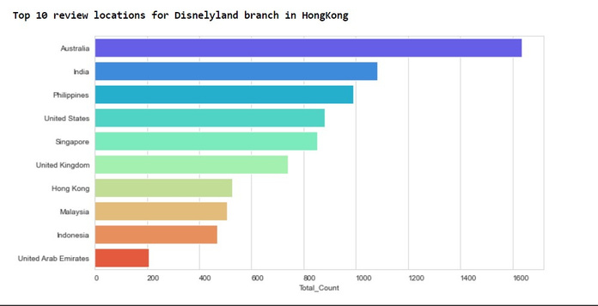
TOP 10
COUNTRIES VISITORS ARE FROM
Visitor nationality depended on location — for example, many Hong Kong visitors are from countries nearby (i.e. Australia, India, Philippines), most of Paris’s visitors are from the United Kingdom, and many of California’s visitors are from the United States

Slide 8
WORD CLOUDS:
We generated word clouds to have a general idea of what visitors talk about when reviewing their Disneyland park experience. In our analysis, we are only interested in reviews written in English and removed duplicated reviews.
To create the word clouds, we tokenized words in the reviews and removed stopwords. There are many ways to customize font, background colors, and contours for word clouds.
01

Slide 9
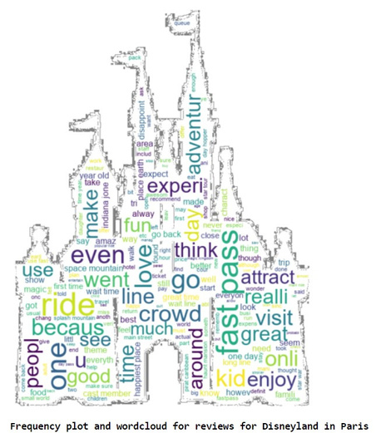
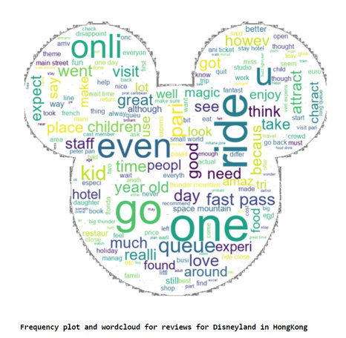
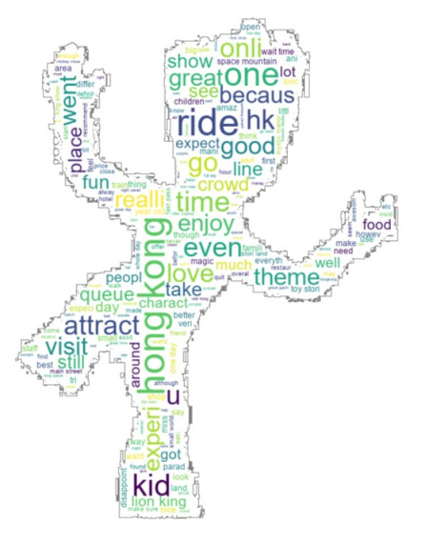
World cloud for Paris
World cloud for HongKong
World cloud for California

Slide 10


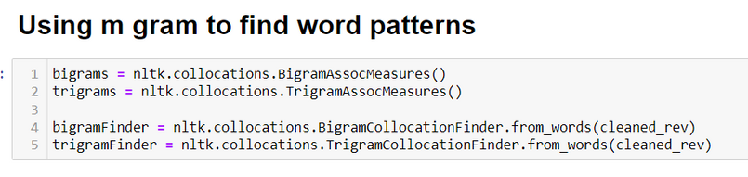
USING N-GRAMS TO FIND WORD PATTERNS
Bigram Association — identifying two words that co-occur frequently to gain more insight into the review context.
Trigram Association — identifying three words that co-occur frequently to gain more insight into the review context. Trigrams may give us more information on what visitors do in the theme parks

Slide 11
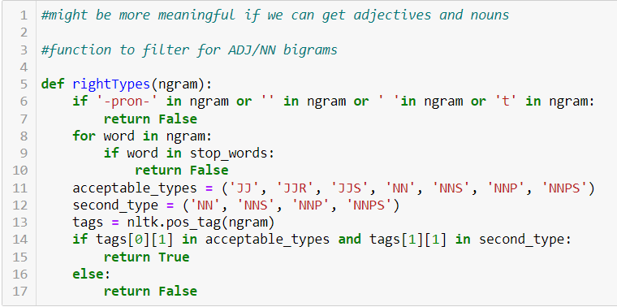
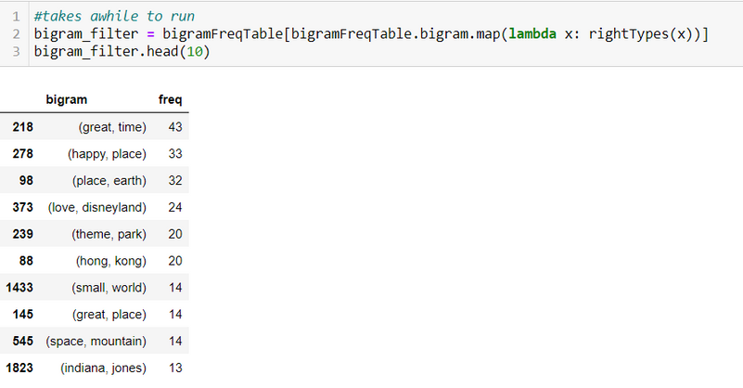
BIGRAM

Slide 12
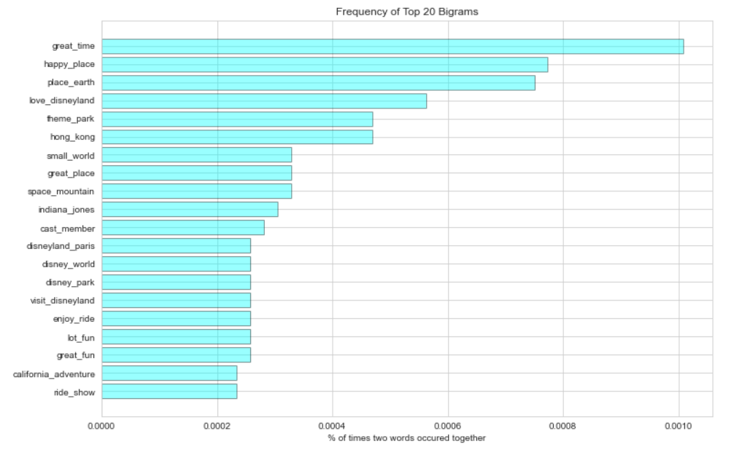
The most frequent bigrams mention popular attractions, type of ticket used (great time, Happy_place ,fast pass), characters (cast member, Indiana jones, peter pan) and wait time.

Slide 13
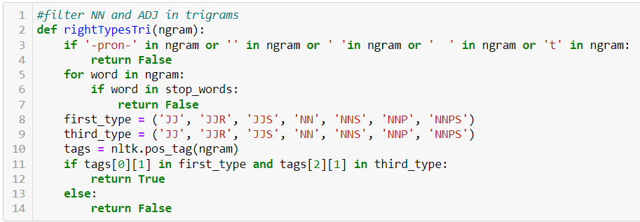
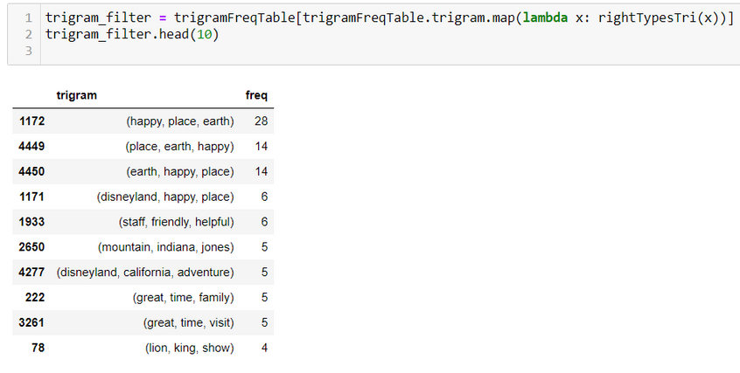
TRIGRAM

Slide 14
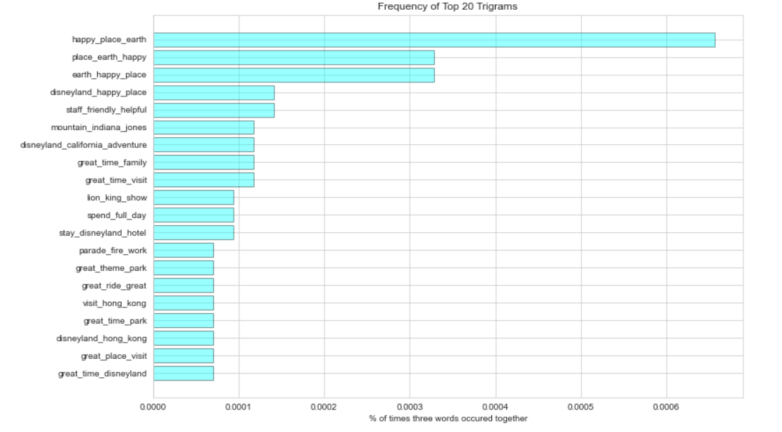
Trigram show a lot of rides! which rides/attractions visitors went to, what kind of tickets they purchased and experience.

Slide 15
Sentiment Analysis
SENTIMENT ANALYSIS IS BASICALLY THE PROCESS OF DETERMINING THE ATTITUDE OR THE EMOTION OF THE WRITER, I.E., WHETHER IT IS POSITIVE OR NEGATIVE OR NEUTRAL.
In this section I will take a closer look into the reviews to reveal visitor sentiment. For this step, I used three methods TextBlob, Vader

Slide 16
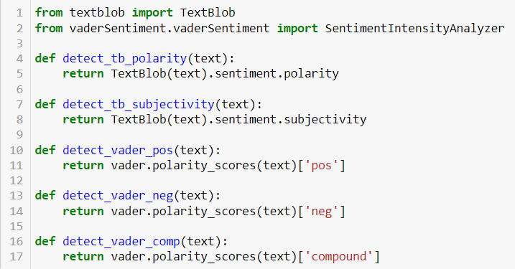
Textblob and Vader
Sentiment Polarity -¶
It is the expression that determines the sentimental aspect of an opinion. In textual data, the result of sentiment analysis can be determined for each entity in the sentence, document or sentence. The sentiment polarity can be determined as positive, negative and neutral. Polarity is float which lies in the range of [-1,1] where 1 means positive statement and -1 means a negative statement.
Sentiment Subjectivity-¶
Subjectivity quantifies the amount of personal opinion and factual information contained in the text. The higher subjectivity means that the text contains personal opinion rather than factual information. Subjectivity is also a float which lies in the range of [0,1].

Slide 17
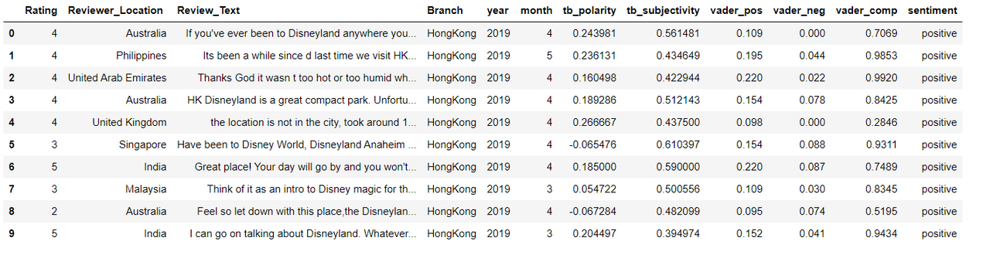
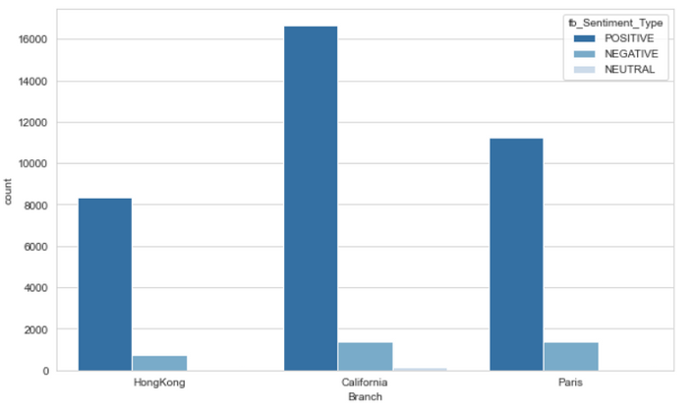
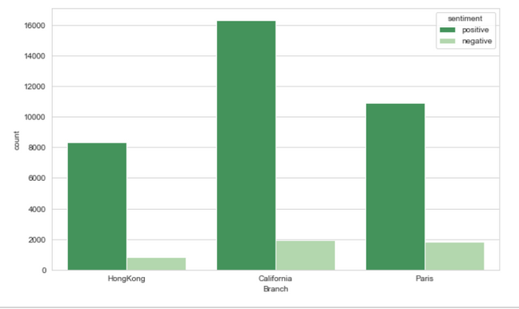
From the graphs above, we infer that reviews with positive sentiment and high polarity scores were extremely satisfied with their park experience. There are more subjective positive reviews than subjective negative reviews. Subjectivity measures how opinionative a review is, so we can infer that those who hold negative opinions gave harsher reviews because their expectations were not met during their visit

Slide 18
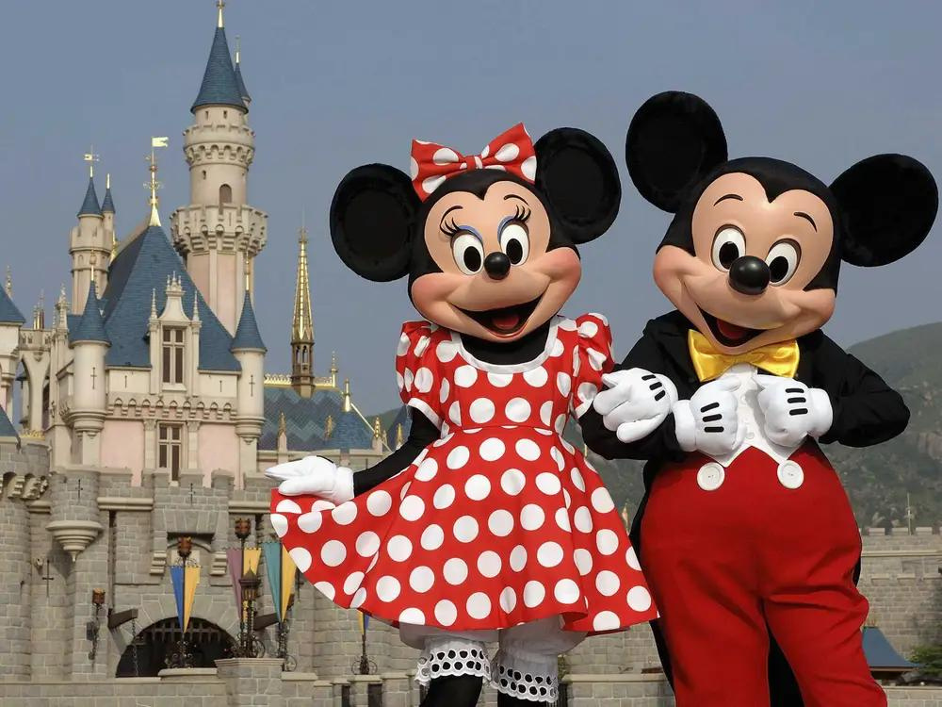

Emotion Analysis
We assigned emotions using NRCLex, which measures emotional affect based on text. The emotional affects include: positive, negative, anticipation, trust, fear, surprise, anger, sadness, joy, and disgust

Slide 19
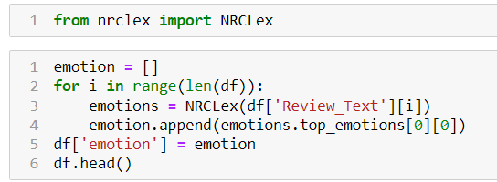
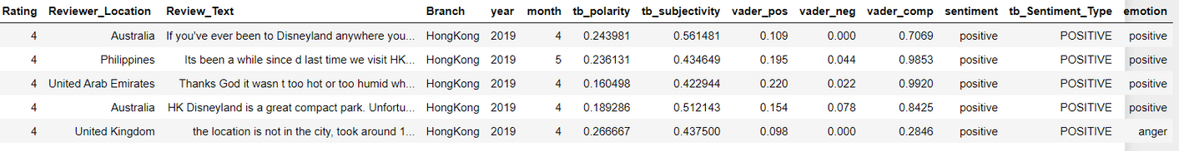
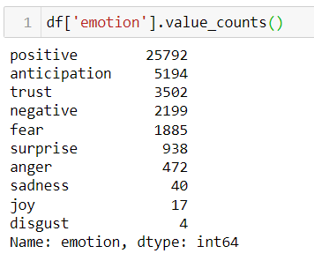
Overall, all three parks have a high frequency of “positive” emotion. However, we have to take a closer look at reviews associated to negative emotions (anger, fear, negative, disgust, sadness) so that we can have an idea of why some visitors had an unpleasant park experience.

Slide 20
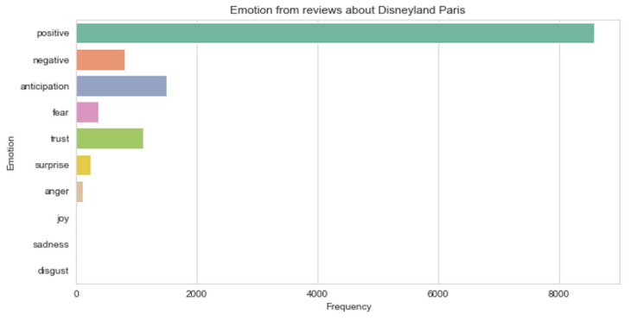
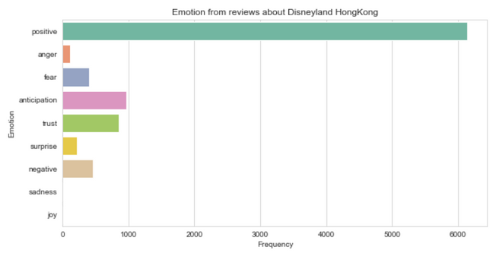
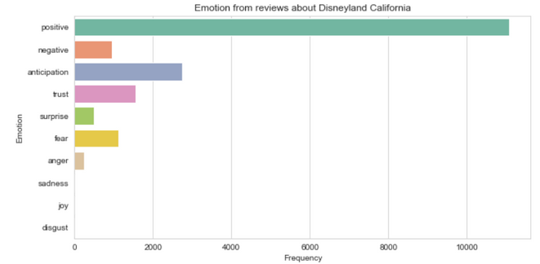
emotion for
Paris
emotion for
hongkong
emotion for
california

Slide 21
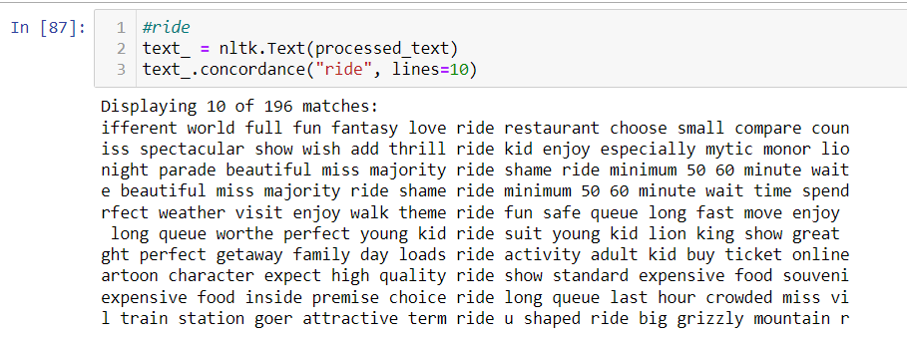
Concordance & Collocation
In the context of NLP, a concordance is a collection of word locations along with their context. You can use concordances tofind:
How many times a word appears?
Where each occurrence appears?
What words surround each occurrence?

Slide 22
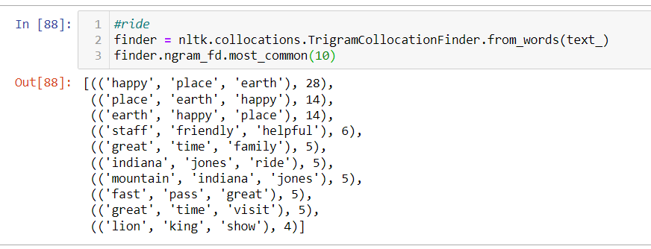
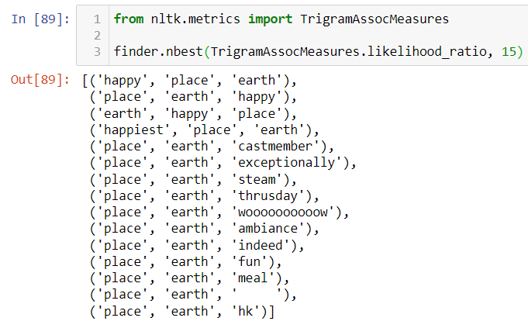
Collocations are series of words that frequently appear together in a given text.
In the State of the Union corpus, for example, you’d expect to find the words United and States appearing next to each other very often. Those two words appearing together is a collocation.

Slide 23
Topic MODELLING
Topic modelling is a technique to extract the underlying topics from large volumes of text
We can use topic modelling to extract keywords used in reviews to help Disney identify specific issues that concern park visitors. We can build a dictionary and train our topic model using an unsupervised learning algorithm, LDA (Latent Dirichlet Allocation) to uncover hidden patterns in the text

Slide 24
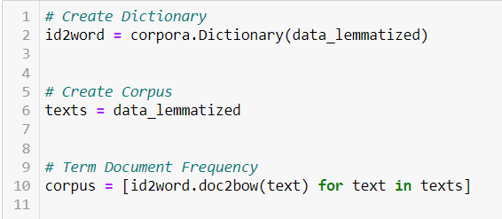
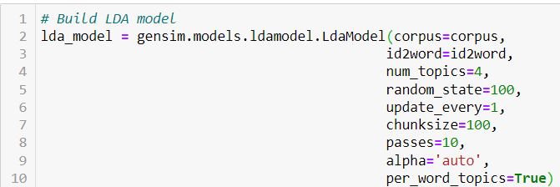
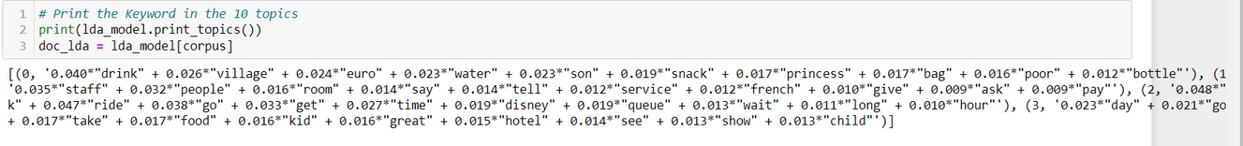
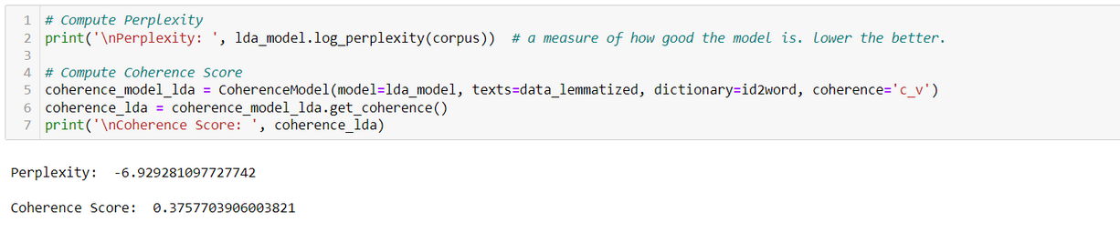
The ideal number of topics is 4. This gave a coherence score of 0.38 and perplexity score of -6.94. Applying this k value, we obtain the top words in each topic:

Slide 25
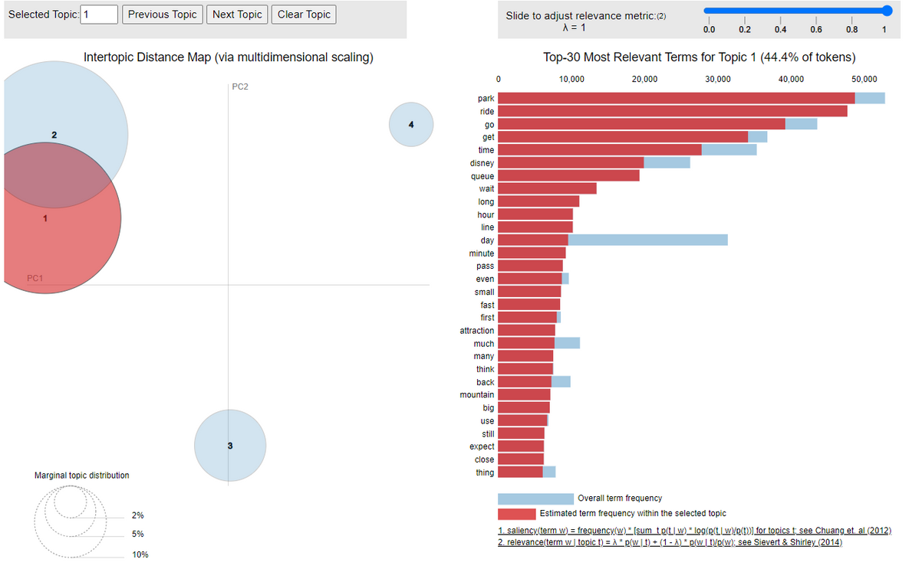
BOO!

Slide 26


From our topic model, we were able to obtain top keywords from each topic:
44.4% of tokens about park, rides,go and get.
41.9% of tokens about positive and fun family park experience.
9.9% of tokens about fast passes, restaurant, hotels and bookings.
3.8% of tokens about customer service, maintainance, staff and behaviour.
By finding key topics, Disney can pinpoint specific areas they can improve to enhance visitor experience. The same technique can be applied to analyze reviews where sentiment is negative in order to find problems that occur in the theme parks.

Slide 27

Classification
Modeling
USING LSTM AND SVM

Slide 28
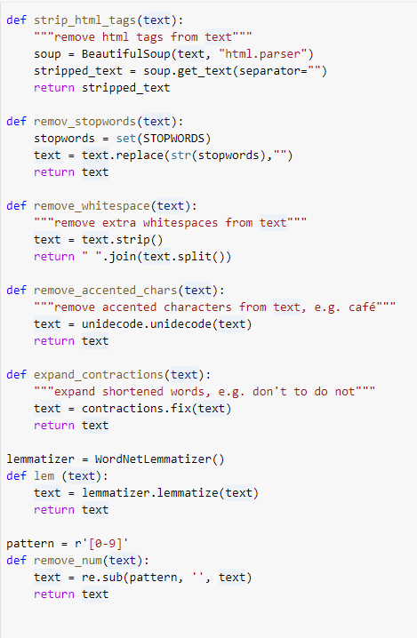
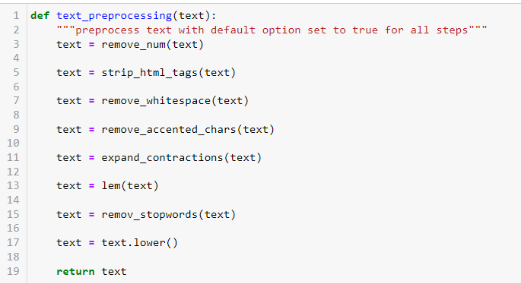
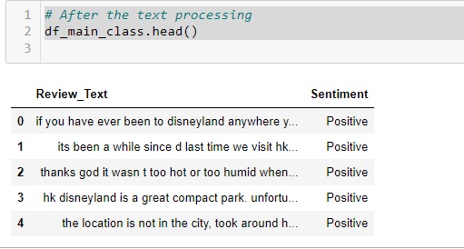
Text Preprocessing
BEFOR WE BUILD THE MODEL WE HAVE TO CLEAN THE TEXT
clean text

Slide 29

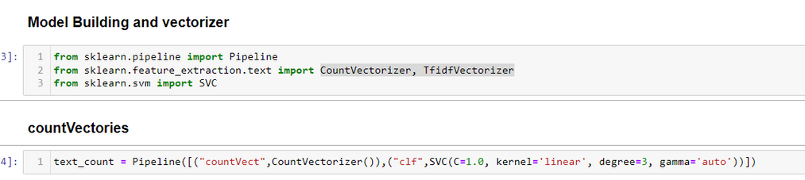
CONTVECTORIZER
TFIDFVECTORIZER
WORD FREQUENCY ANALYSIS
TERM FREQUENCY-INVERSE DOCUMENT FREQUENCY
Converts text into a numerical representation by counting the frequency of each word in the text and creating a matrix, which is commonly used in text preprocessing and analysis.
A weighting scheme that measures the importance of each word in a document based on its frequency and rarity in the corpus, often used in information retrieval and text classification tasks to rank and classify documents.
02

Slide 30
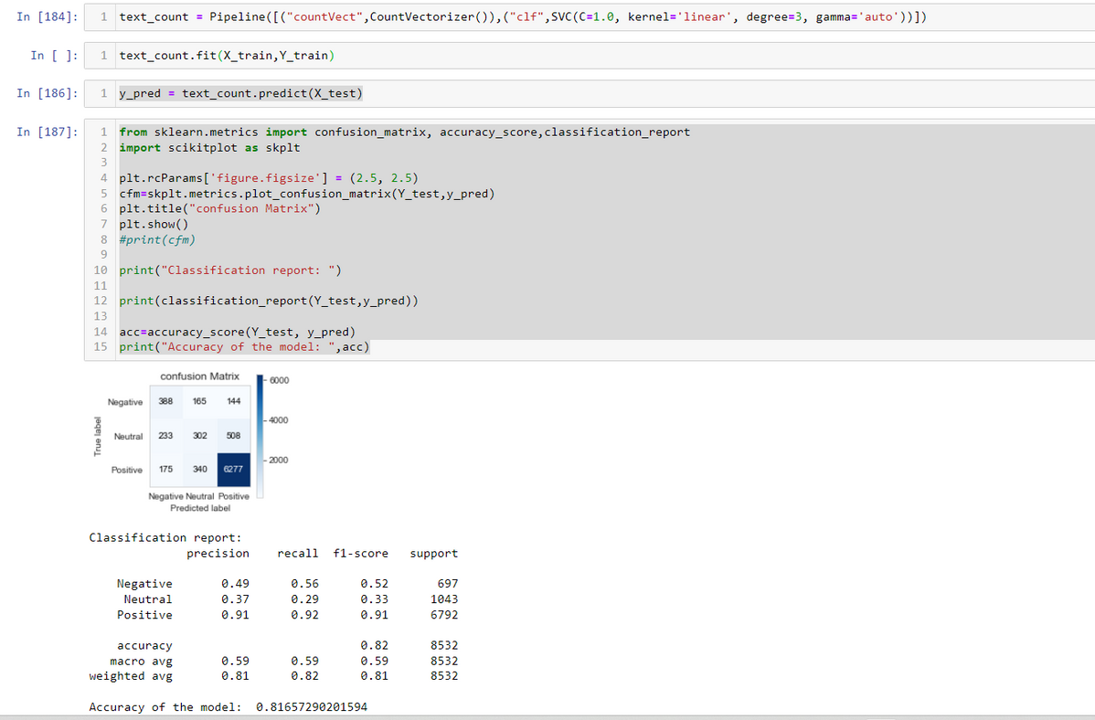
SVM
Using CountVectorizer
81%
accuracy obtained

Slide 31
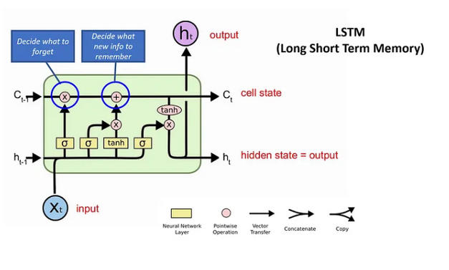
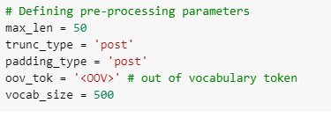
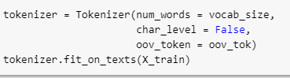
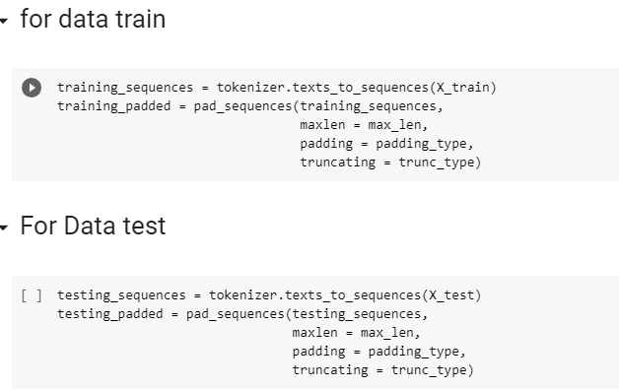
LSTM
Tokenizer
The Tokenizer API from TensorFlow Keras can split sentences into words and encode them into integers.
The Tokenizer will perform all the necessary pre-processing steps:
tokenize into word character (word level) num_words for maximum number of unique tokens filter out the punctuation terms convert all words to lower case convert all words to integer index
Sequence and padding
The next step : Let’s represent each sentence by sequences of numbers using texts_to_sequencesfrom Tokenizer object. After that, we padded the sequence so that we can have same length of each sequence.

Slide 32
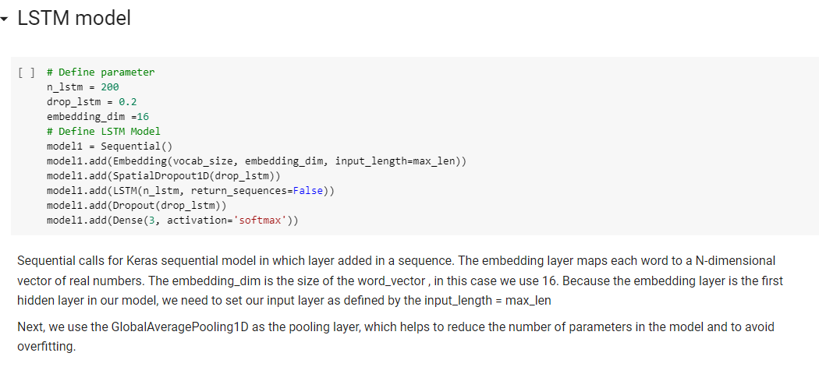
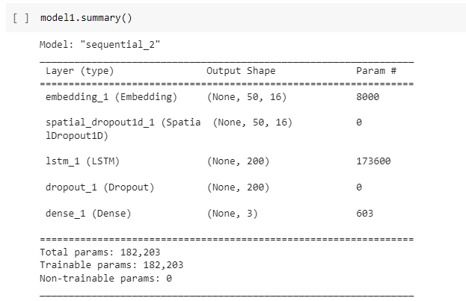

Slide 33
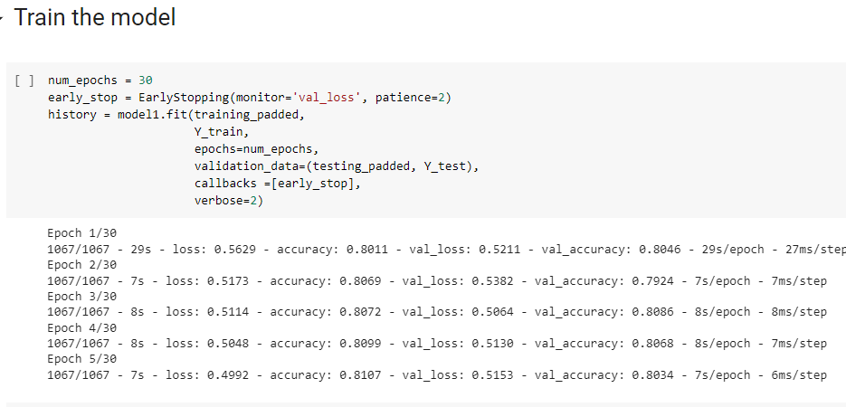
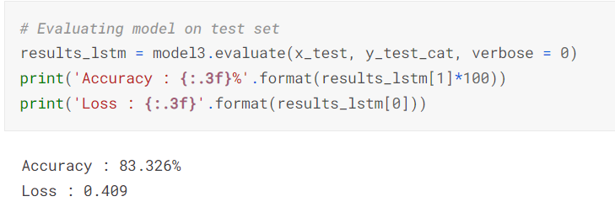
83%
accuracy obtain

Slide 34
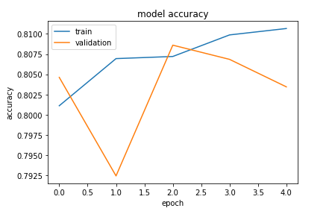

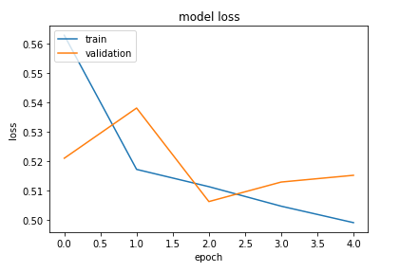

Slide 35



Futher Analysis
We can delve deeper on understanding more about when common park issues occur by comparing reviews by month. We can also analyze reviews over different years to inform us if each branch attempted to make changes that improved visitor experience
Recommendation
Many visitor pain points stem from frustration of waiting in line and crowds. A large amount of time is spent standing in line, which irritates people and contributes to a more negative experience. Another common pain point that contributes to the problem with long lines is park capacity — more visitors mean longer wait times for attractions and food. Disney should take steps to alleviate symptoms of a negative park

Slide 36


THANKS FOR LISTENING!

